Slide 1
Facebook Timeline for Brands:
How Hoteliers Can Take Advantage

Slide 2
Welcome to today’s Webinar
Visit www.facebook.com/vizergy

Slide 3
What you will learn today
After today’s webinar, you will know:
If Facebook matters to your hotel’s success
What Timeline features are and what they do
How to update your hotel’s Page to Timeline
What is on the horizon for Facebook

Slide 4
Facebook: in perspective

Slide 5

Facebook: Reach
Notes:
845 Million users are registered worldwide
That is Reach – sheer number of people; more people on facebook than there were on the planet 200 years ago
Google to reach 1B active users per month but not a destination site.
Facebook is the destination. It has the stickiness. It is the site that keeps Larry Page up at night.
That means something in terms of its staying power and the potential for advertising.

Slide 6
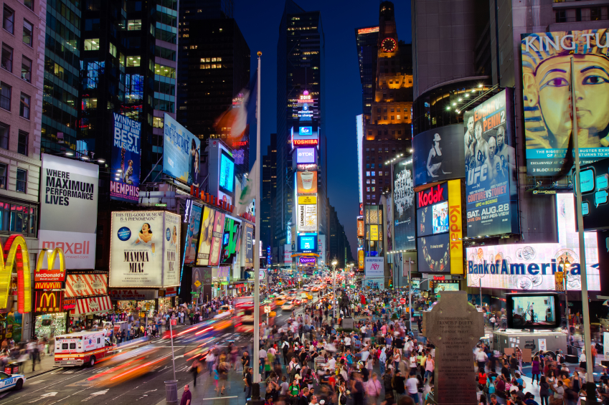
Facebook: Frequency
Notes:
483 Million active daily users
Frequency – how often are they are on facebook and how easily can you connect with them?
Amidst a wild proliferation of marketing messages at every turn, how do you get personal and get to know your guests?
Targeting by demo, geo, interest, status…
What other platform lets you target women in the bay area between the ages of 18 and 35 who are in a relationship but not married or engaged, like Gossip Girl and Coca Cola and knitting and work for the Gap? Not one…but Facebook.

Slide 7
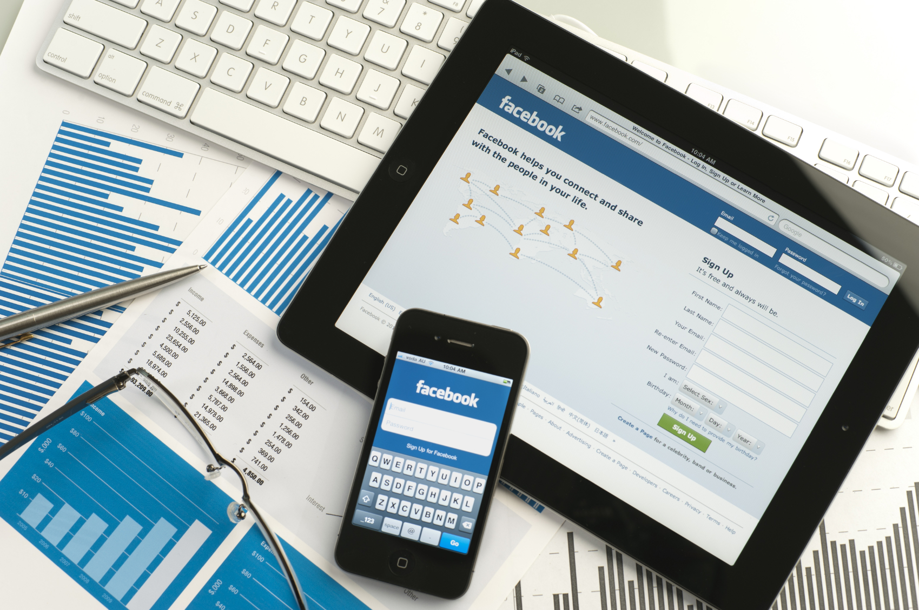
Facebook: Connectedness
Notes:
425 Million users connecting via mobile
Constant connectedness – users pick and choose where to find you, how to find you and when and where they will interact with you. Can you afford to not be where they are?
The three forces that have most influenced technology, marketing/advertising and communications:
Social
Mobile
Local
Social: answers man’s desire to connect and feel connected to others. Answers marketers dream to know his target.
Mobile: wherever you may go, you are a touch away from all the world’s information.
Local: discovering what is around us, who is there, how to go, what to do
Facebook is all three – it IS social. Period.
It is mobile on apps and tablets, it’s what you do while you wait at the doctor’s office, in line at the store, at a red light.
It is local: check-ins, recommendations. When I lost the citrine stone in my ring, I solicited my facebook friends for the best jeweler in town where I could have it replaced. Every Tuesday, I know where I can find my friend Clinton when he check in at the Taco place near the gym for $4.99 taco tuesdays.

Slide 8
Timeline for Brands

Slide 9
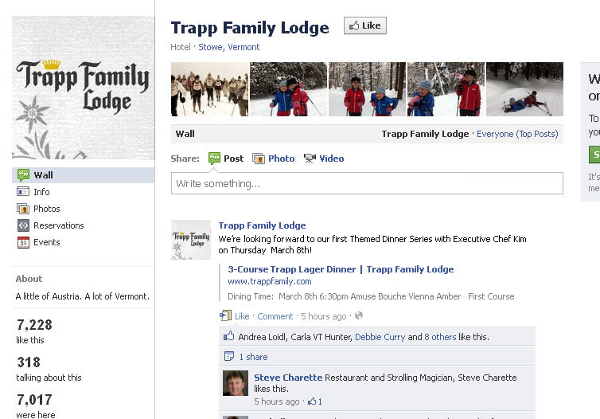
Facebook Page Before

Slide 10
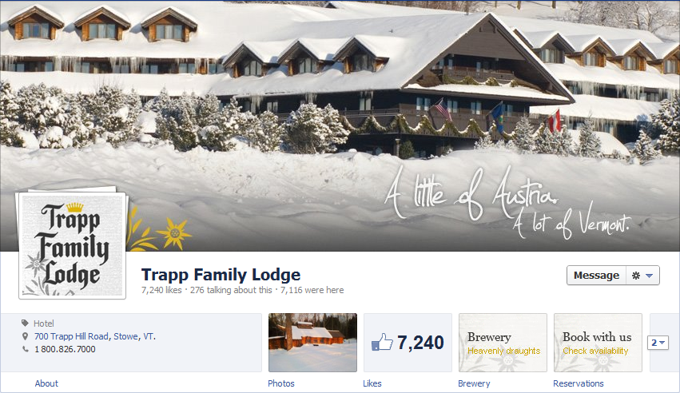
Facebook Page After
Notes:
This is where the new facebook timeline is your greatest asset:
More visually interesting, customizable, stimulating layout that allows you to tell a story, to be your brand, to entice
Not here to say that Facebook is a new channel to compete with OTAs for direct bookings – it is not. It is you, your brand, your newest, most personalized, most flexible, most immediate ad campaign,

Slide 11
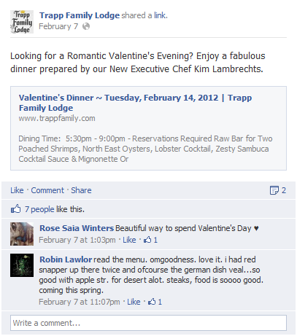
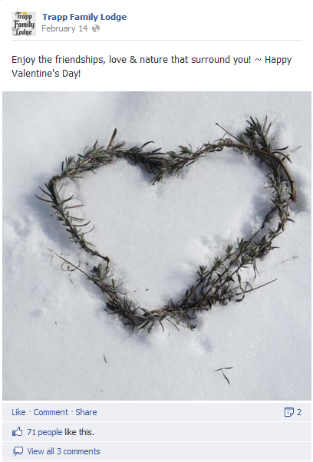
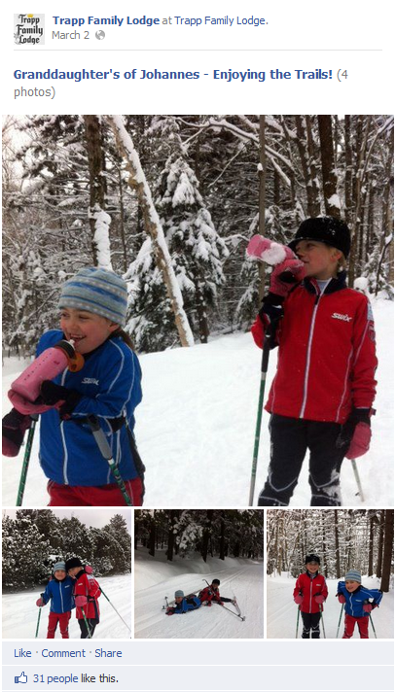
Inviting friends, being real
Entice and invite
Build a relationship
Get personal
Notes:
Potential to reach present, current and future guests
connect with them in a meaningful, personal way
Building relationships, solving problems, providing service, value, memories
- You have the power to create enticing, warm invitations…staying top of mind with your past guests, drawing in the new
Build relationships to create advocates. These are the people who will recommend you to their friends, post pictures of your property to their -page, write rave reviews on TA
Get personal and be real. How do you showcase your personality? Imagery, words, posts. If Timeline *is* your ad campaign, what does it look like and what does it say?

Slide 12
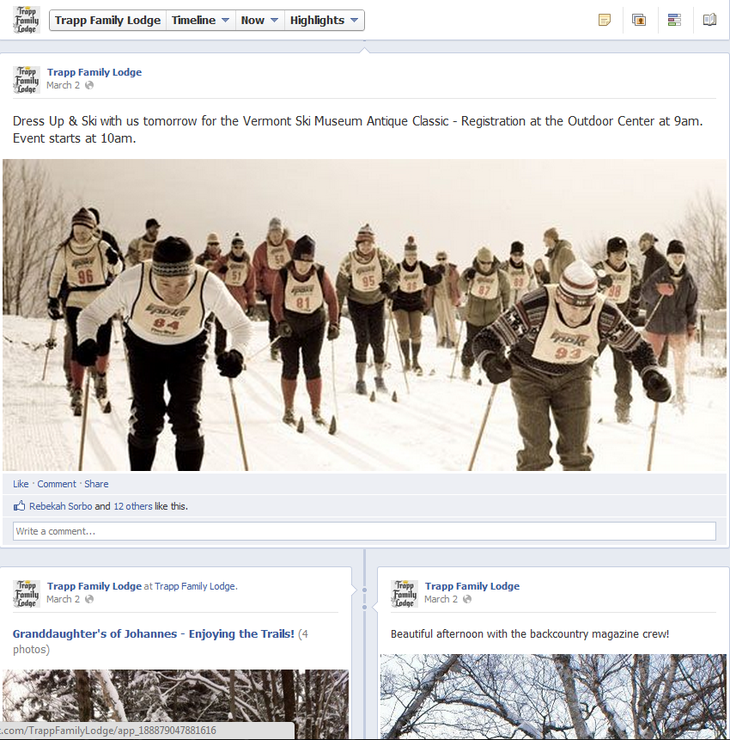
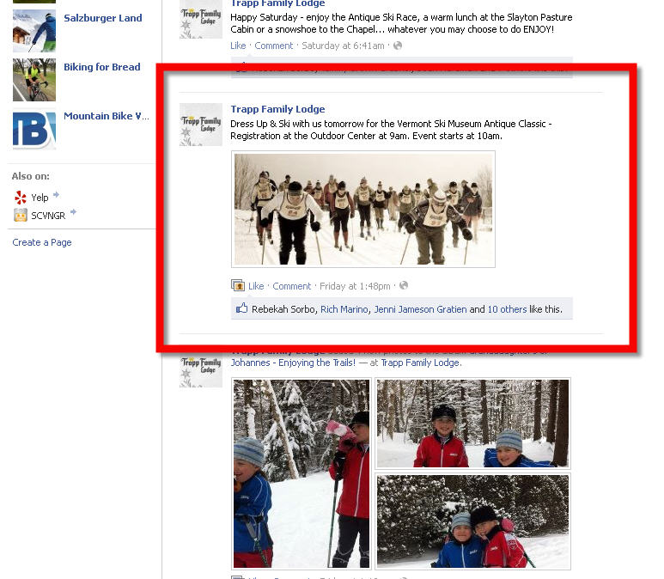
Featuring Content
Notes:
Before – one lackluster image after another. Beauty of your imagery lost in a less than stimulating background.
Now – highlight posts, videos, images and make them stand out. Recreate the feel of an on property experience on your timeline

Slide 13

Timeline: the specifics
Profile picture
Aggregation
Page statistics
Insights
About
Milestones
Date selector
Asset sizes
Events
Cover photo
Page settings
Logout
Composer
Likes tab
Premium ad stories
Friend activity
Pinned posts
Starred posts
Views and Apps
Admin panel
Tabs
Direct messaging

Slide 14
Summary of Timeline features
Express your identity with visually interesting features
Reach your audience wherever they are
Respond to people quickly, directly and personally
Profile picture
Aggregation
Cover photo
Pinned posts
Tabs
Views and Apps
About
Milestones
Events
Asset sizes
Starred posts
Insights
Friend activity
Premium ad stories
Page statistics
Composer
Likes tab
Page settings
Logout
Admin panel
Direct messaging
Notes:
Phew
We will not be covering Facebook advertising today, but please sign up for our newsletter if you have no already to receive word of future webinars on the topic!

Slide 15
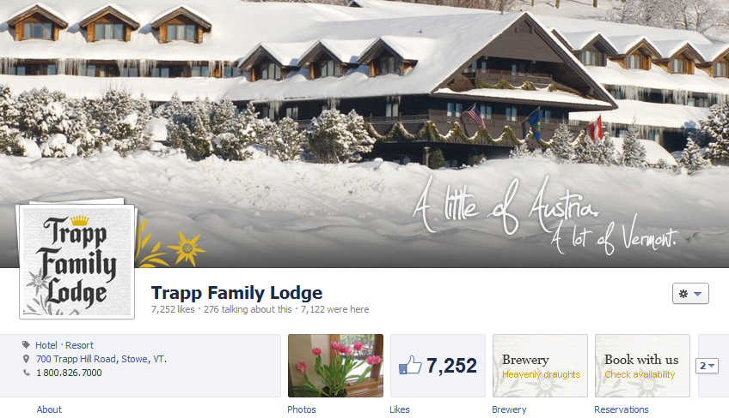
Cover Photo
Profile picture
Tabs (Views and Apps)
Notes:
Let’s look at these elements one by one so you understand what changes are necessary
First, you immediately get a sense of for how much more Visually engaging the design is.
The key elements you need to address here are:
Cover photo – this is what sets the tone for your page, it should be your showcase, the one image you want to stick with your guests. It should portray your property, the experience of your property and the feel a guest can expect. More examples to come…
Asset size: 851 x 315pixels
Change as often as you like, but be aware of a few things: no rates, discounts, promo messaging, no contact info, no references to facebook features like like or share, no calls to action.
Profile Picture: most often your property logo. 125x125 (should scale from 180x180 down to 32x32 for use all around fb)
Sits 23px from the left of the cover photo and 239 px from the top
Tabs: navigation icons for tabs and apps, four will be featured , up to 8 in the dropdown. Icons are 111x74px and take the place of the left navigation on old brand pages. These can be custom (reservations tabs, restaurant tabs) or native facebook apps (Likes, maps, videos, etc) Photos can not be edited or removed. Last photo updated will always display.
About and page stats: About can be edited – update property type, address, phone number.

Slide 16
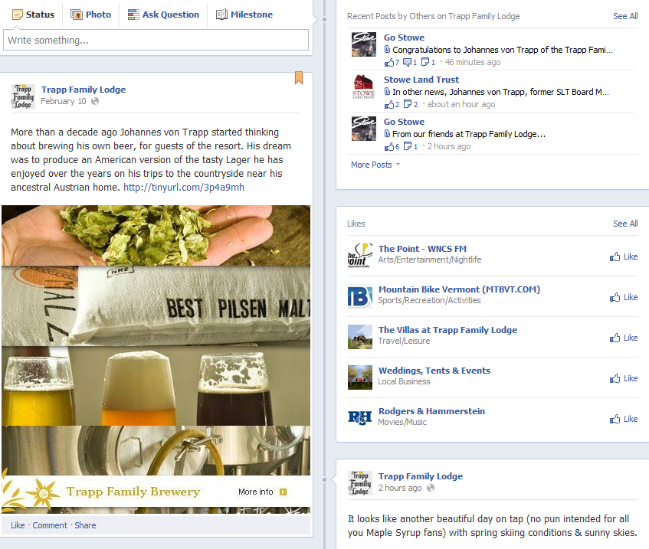
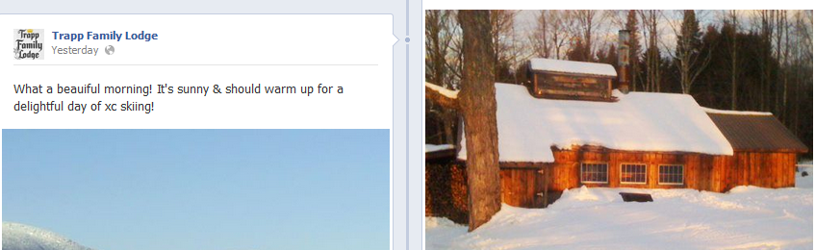
Related activity
Pinned post
Larger stories
Notes:
Allow – allow users to post
Star – double wide, spanning width
Hide –
Back date
Pin – brings to top for 7 days: event stories, links, photos, campaigns, polls, fan photos, fan videos, contests

Slide 17
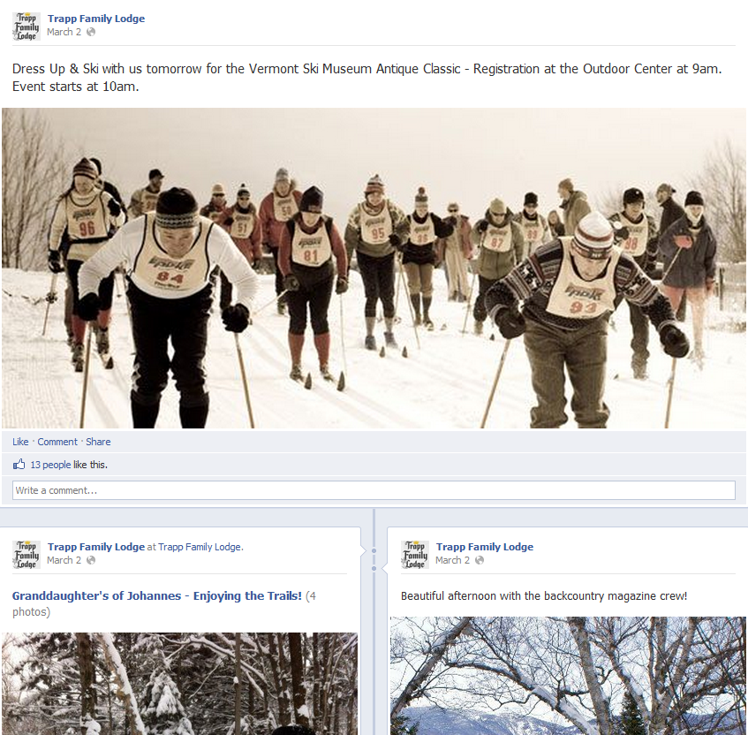
Starred Stories

Slide 18
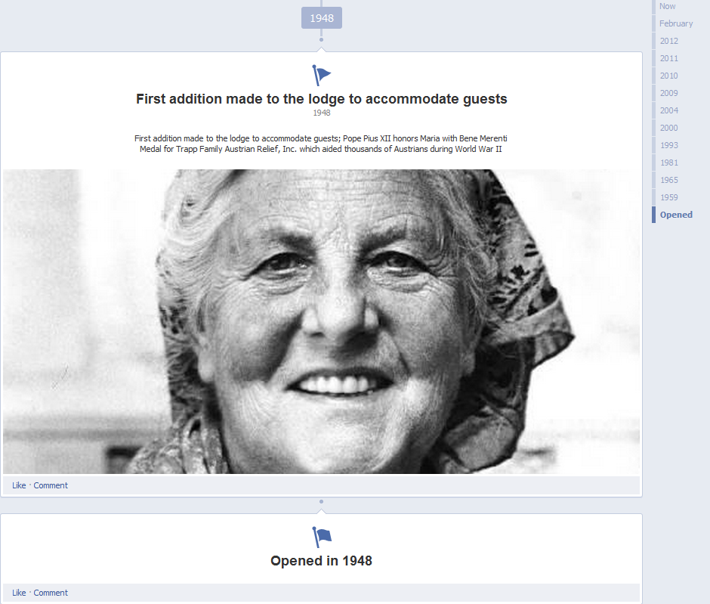
Timeline
Milestones

Slide 19
Your timeline.
Your hotel’s story.
Your guest relations.
Your chance to connect.

Slide 20
Timeline: making the switch

Slide 21
Prepare now
Curate your timeline now.
On March 30, all business pages will automatically take on the new Timeline.
Take a trip down memory lane before that date
- star the positive
- pin your best
- hide the potentially negative/irrelevant
Preview the new format and adjust as needed.
Notes:
Remember most active posts will stick to timeline; others will fall off. Be sure to star and elevate those you most want to have guests see/remember and remove those you would rather not

Slide 22
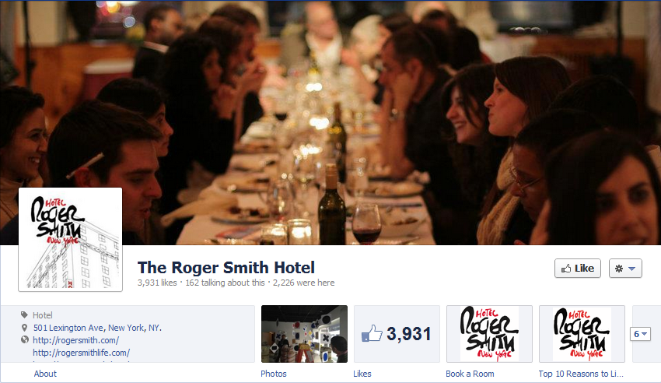
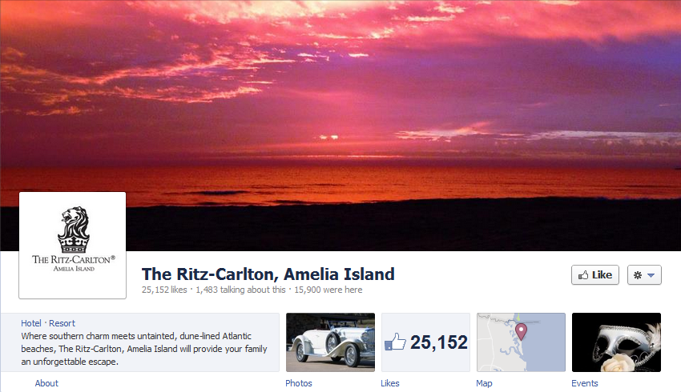
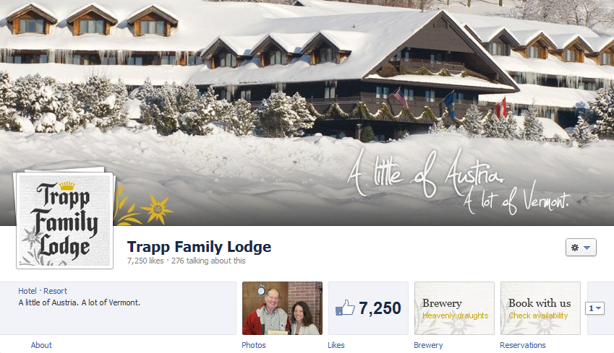
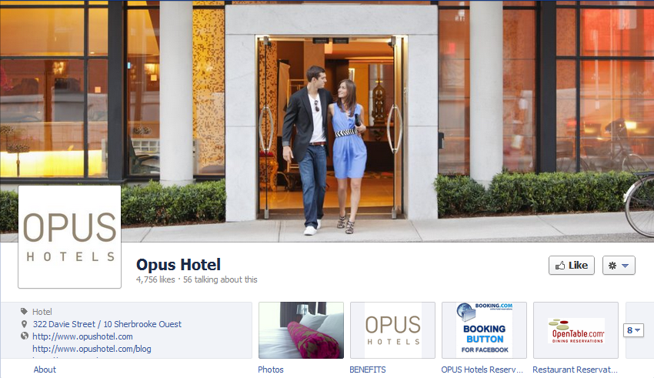
A picture’s worth 1000 likes?
Get visual.
Notes:
Each image tells a story about your property – what do you want guests to see? Feel? Think?
What if you changed the image regularly? Seasonally? Based on happenings at the property?
What if your cover photo set the tone for a guest’s stay?
Roger Smith – social, dining, friendly, elegance
Ritz Amelia – natural beauty, relaxation
Trapp – cozy, family, winter wonderland
Opus – young, sleek, modern
With just a cover photo, we identify the property, its essence, its message, its feel and we have an expectation for our stay

Slide 23
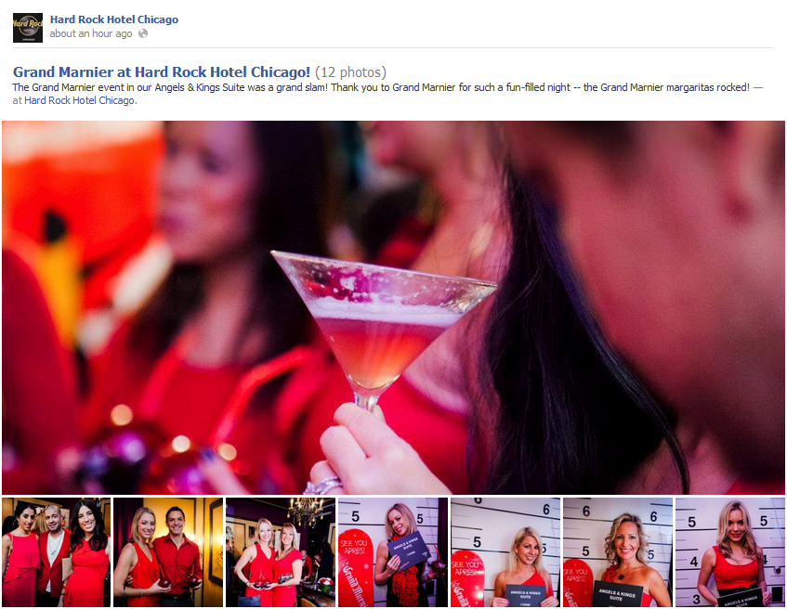
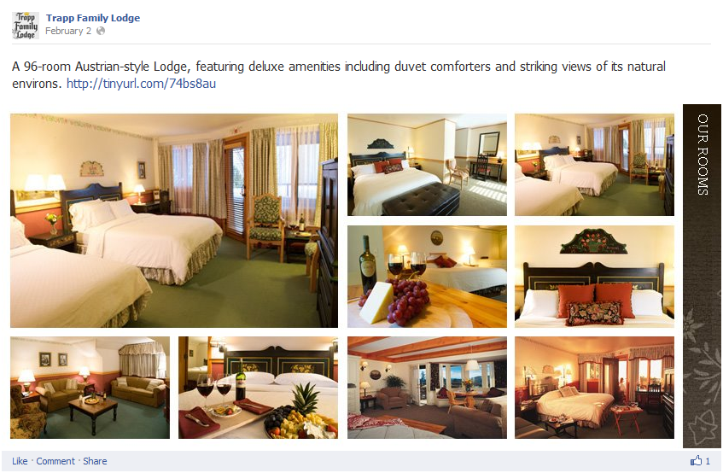
Highlight your favorites
Notes:
Talk about editing dates (backdating) on posts, to move them up or down on the timeline
Custom develop images to showcase your assets. Starred posts are featured posts and can take up the full width of the timeline.

Slide 24
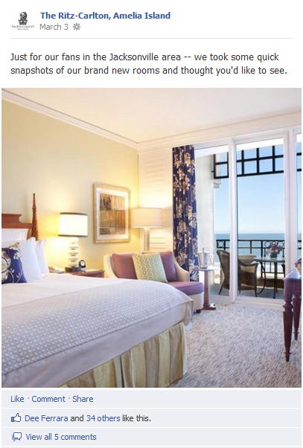
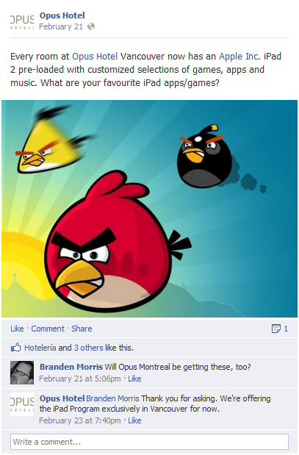
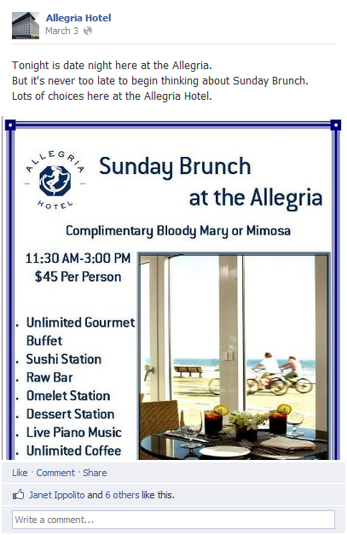
Posts with punch
Notes:
Talk about pinning posts –
Create promotions in an image, then pin them for 7 days to draw attention to them
Track activity on these pins to see what users respond to by using insights
Album stories will feature one main image and a strip of photos underneath
Think about posting albums of events on property…
Recap“:
Allow – allow users to post
Star – double wide, spanning width
Hide –
Back date
Pin – brings to top for 7 days: event stories, links, photos, campaigns, polls, fan photos, fan videos, contests

Slide 25
Make history
Notes:
Like Life Events for users, milestones tell the business’s story. All freeform –
Enter founding date, then choice of fields: event, location, when, story, video or photo (all optional except event)
Milestone photos are 843x403px

Slide 26
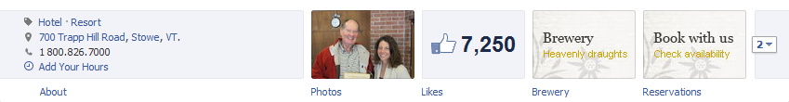
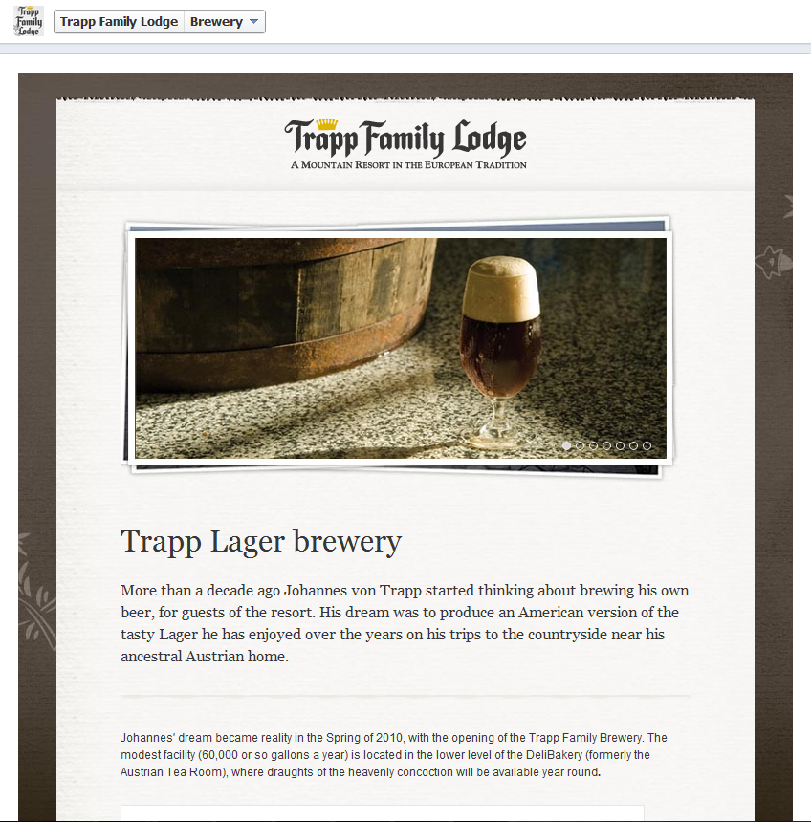
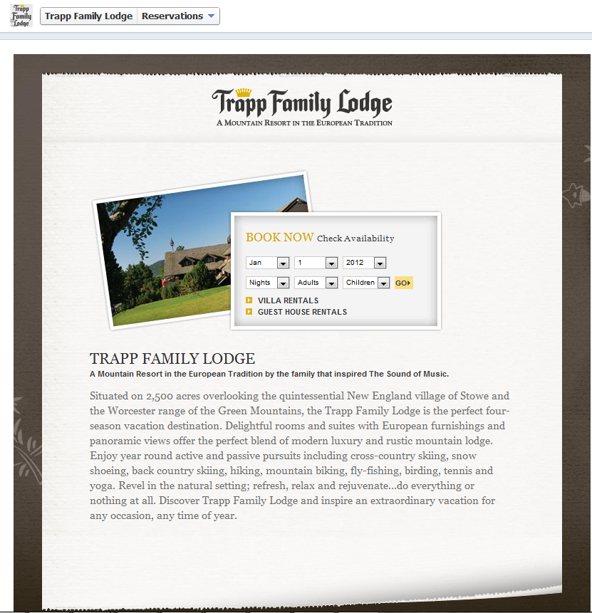
Adjust your tabs
Notes:
Tabs are still here, but some changs
Now below the cover photo,
4 tab icons (111x74px) displayed at once, others behind a scroll
Tabs themselves have two widths 520px for legacy tabs and 810px to take advantage of new facebook real estate
Old tabs are ok in the new layout, but will simply not take advantage of the full width
No more default landing tabs – all users land on brand timeline – think of new ways to get people to custom tabs if you want to “like gate” (define like gate)
Reservations tabs
Restaurants, spas, golf courses
Story of your property
Specials page
Anything unique?
Contests?

Slide 27
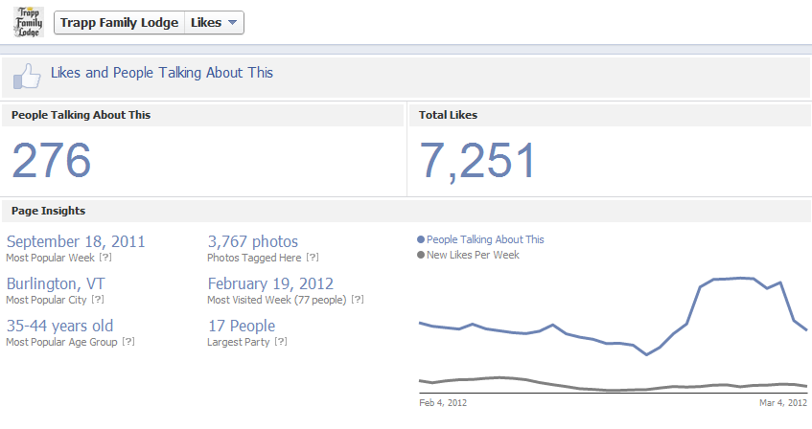
Adjust your tabs: Likes tab
Notes:
# of people talking
Total likes
Most popular week, city, age group
Convos/likes on graph
Facepile
No control here.

Slide 28
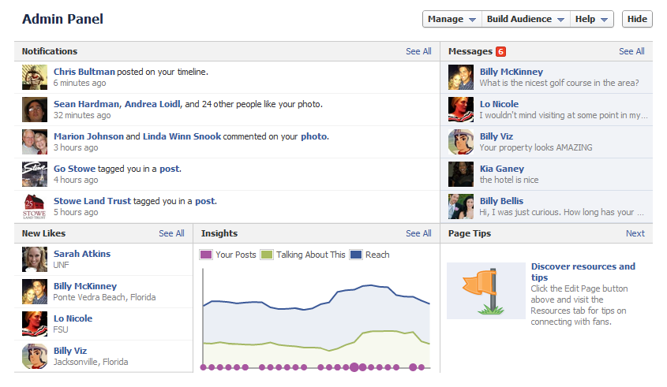
Admin panel
Notes:
Notifications – lets you respond immediately when someone talks about you
New likes – see who is connecting to you
Direct messages – your inbox for messages directly sent to you
Insights – surfaces info on how many people you are engaging with

Slide 29
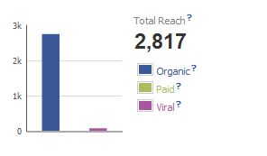
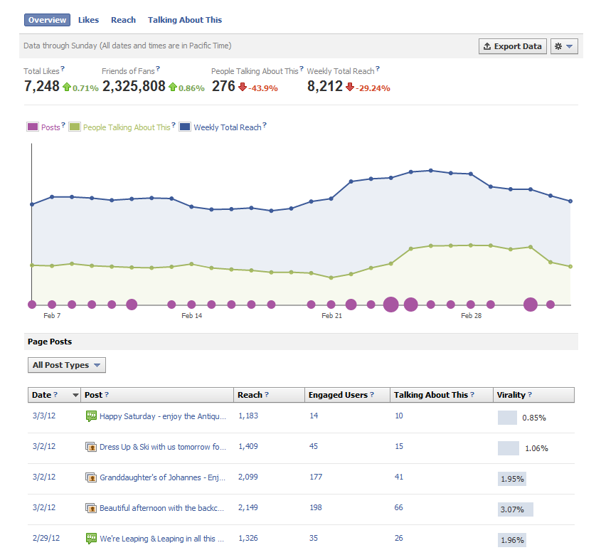
Notes:
Overview of Insights – what data points are there? And why do they matter?
Total likes – total number of fans
Friends of fans – number of unique people who were friends of fans
Reach – number of unique people who have seen your post
People talking about this – number of unique people who created a story in the previous week
Weekly total reach – unique people who have seen any content associated with your page
Engaged users – number of unique people who clicked on your post – click to split between photo views, other clicks, stories generated
Talking about your post – number of unique people who have created a story from your page post (likes, comments, shares, answers, responds) – click for likes, shares, comments distribution
Virality - % of people who have created a story from your page post out of the totally number of unique people who have seen it

Slide 30
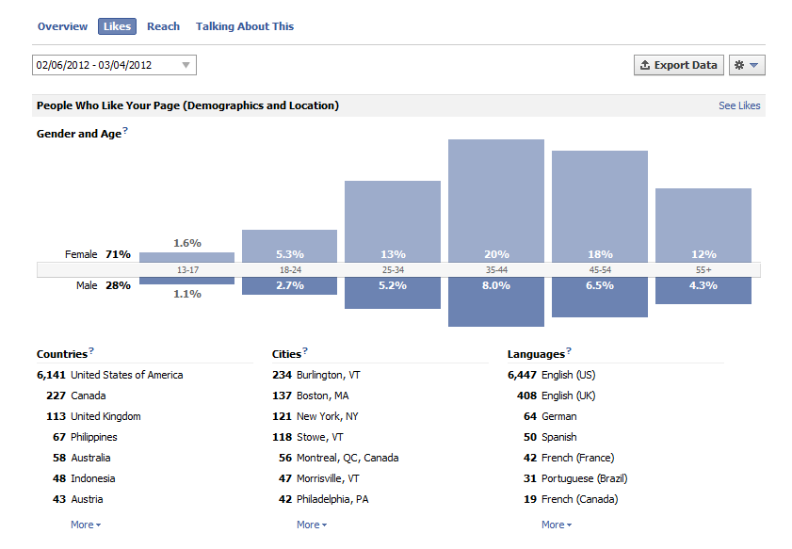
Notes:
We saw overview, then there is Likes, Reach, Talking About This with deep dive analysis into each
Likes: demo, where likes come from (facebook recommendations, admin invites, on page, mobile, etc)
Reach: demo, how you reached people (organic, viral, paid), frequency, page views, unique visitors, tab views
Talking About this: demo, how people are talking and about what
Why? Better insight into what is working, but also better insight into how to target….ADS

Slide 31
Timeline: tapping into your audience

Slide 32
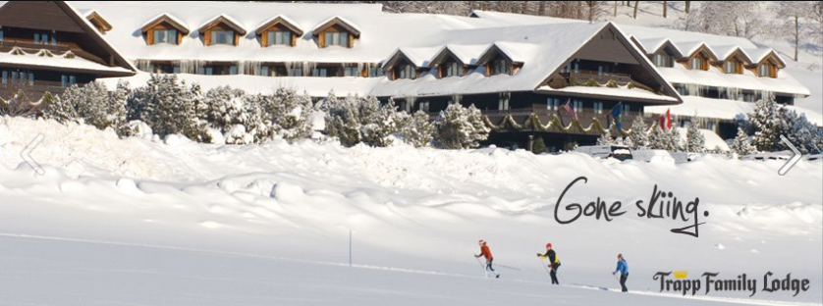
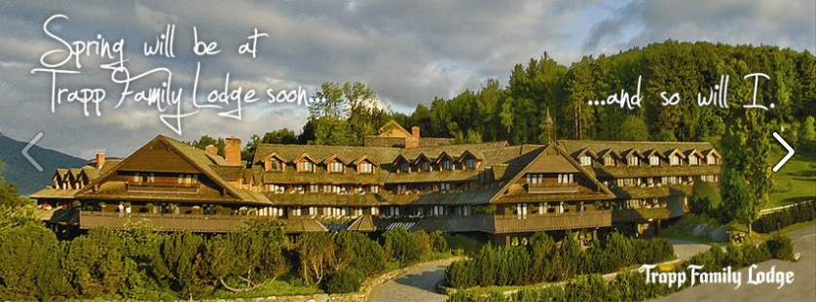
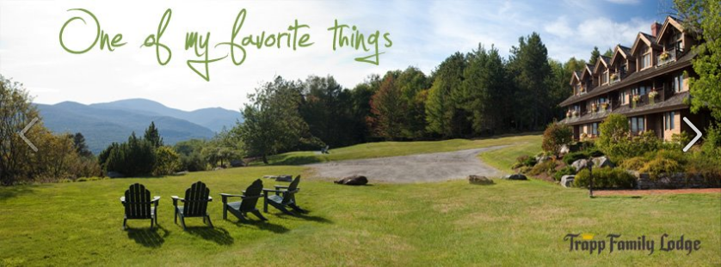
Share and be shared

Slide 33
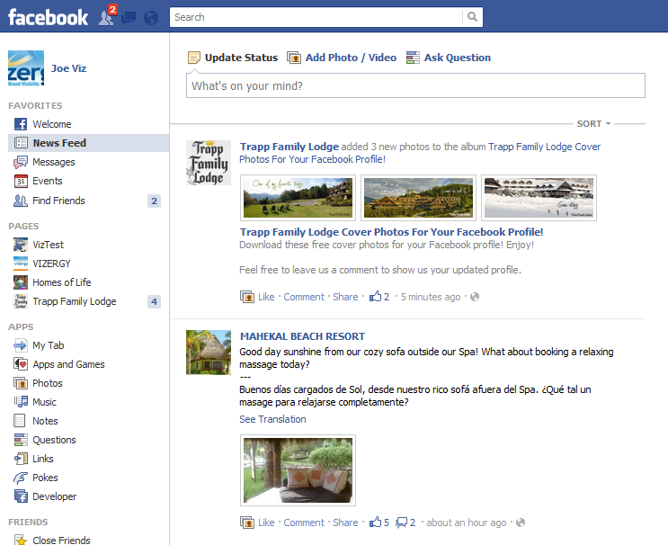
Share and be shared

Slide 34
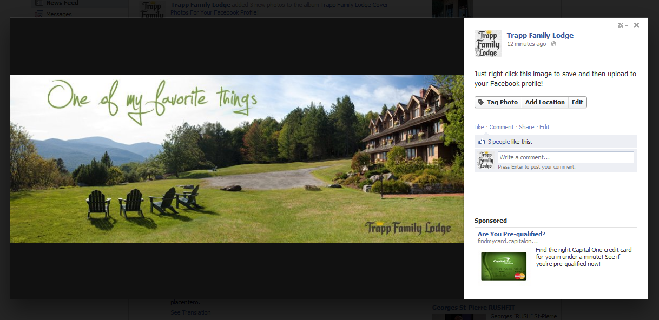
Share and be shared

Slide 35
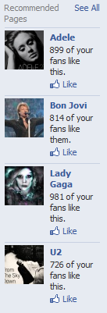
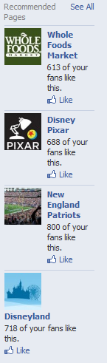
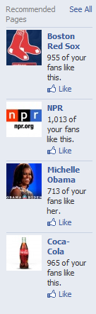
Get to know your audience
Study Insights and follow Facebook recommendations to gain valuable insight on your fans.
Utilize this information to target Ads and to create advertising promotions that will speak to your fans.
Notes:
Use demographics (age, gender, location) to better target your ads, either by honing in on the demo of your fan base, or by creating an ad campaign to create a new demographic.
Utilize suggestions from facebook on what your fans likes and interests are – like those same things, post to those pages as your page, interact with the core of your fanbase where they are on facebook. Also use likes and interests to target your ads more precisely.
Think outside the box….looking at the musical preferences, if Gaga comes to town and you are located near the arena, what kind of special offer could you put together for fans attending the show? How can you personalize and customize your promotions and marketing to better match your guest’s profile?

Slide 36
Timeline: the future

Slide 37
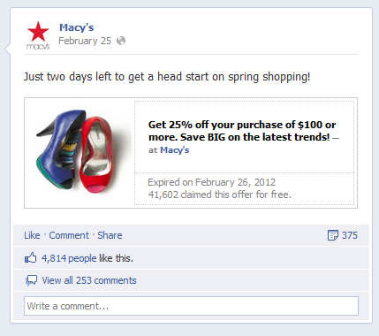
Facebook: the future
Coupons: currently in beta
Notes:
Build couponing directly into appls
Post to timeline
Redeem directly inline, triggering an email
Share with friends, post on their own timelines
Native facebook ingishts, custom stories generated when users redeem, sponsored stories
No timeline yet.

Slide 38
Timeline: a hotelier’s view
Today’s takeaways:
Facebook is 21st century CRM - literally
Timeline tells my story and is my promotional material
Eyes to the future for Ads, Coupons and more

Slide 39
Questions? Visit www.facebook.com/vizergy or email us at results@vizergy.com

